Slide 1
Secure data hiding in images using Steganography
CAPSTONE PROJECT
Presented By: Akriti Panwar
Student Name: Akriti Panwar
College Name & Department: GLA University, Mathura, Uttar Pradesh & Computer Science and Engineering

Slide 2
OUTLINE
Problem Statement
Technology used
Wow factor
End users
Result
Conclusion
Git-hub Link
Future scope

Slide 3
Problem Statement
Data security is crucial in the digital world, especially when transmitting sensitive information. Traditionally encryption methods can be complex and require external storage for encrypted files. This project introduces an image-based encryption and decryption system that allows users to hide secret messages inside images securely. The decryption process is protected with a password, ensuring only authorized access.
Challenges Addressed:
Difficulty in securely sharing text messages.
Risk of data exposure in plaintext format.

Slide 4
Technology used
Programming Language:
Python – The programming language itself, provides the logic and structure.
Libraries & Frameworks:
OpenCV – Handles image processing and manipulation.
Character Encoding (ASCII): The code uses ASCII encoding to convert characters to numerical values and vice versa.
Basic image steganography: The core algorithm hides data by altering the least significant bits of pixel values.
Platforms:
Runs on Windows, Linux, and macOS with Python installed.

Slide 5
Wow factors
Why is this project Unique?
Steganography-based encryption – Instead of traditional encryption, the message is embedded within the pixel values of an image.
Password protection - The message can only be decrypted with the correct password, adding a layer of security.
Potential Applications: The concept has applications in fields like security and data protection.
Simplicity: The simple yet effective method of encoding and decoding.

Slide 6
End users
Cybersecurity Enthusiasts – To explore encryption steganography techniques.
Journalists & Activists - Securely share confidential information without detection.
Students & Researchers - Learn about cryptography and image processing.
Photography & Designers – Protect copyright information within images.
General Users – Hide private messages or data securely within images.

Slide 7
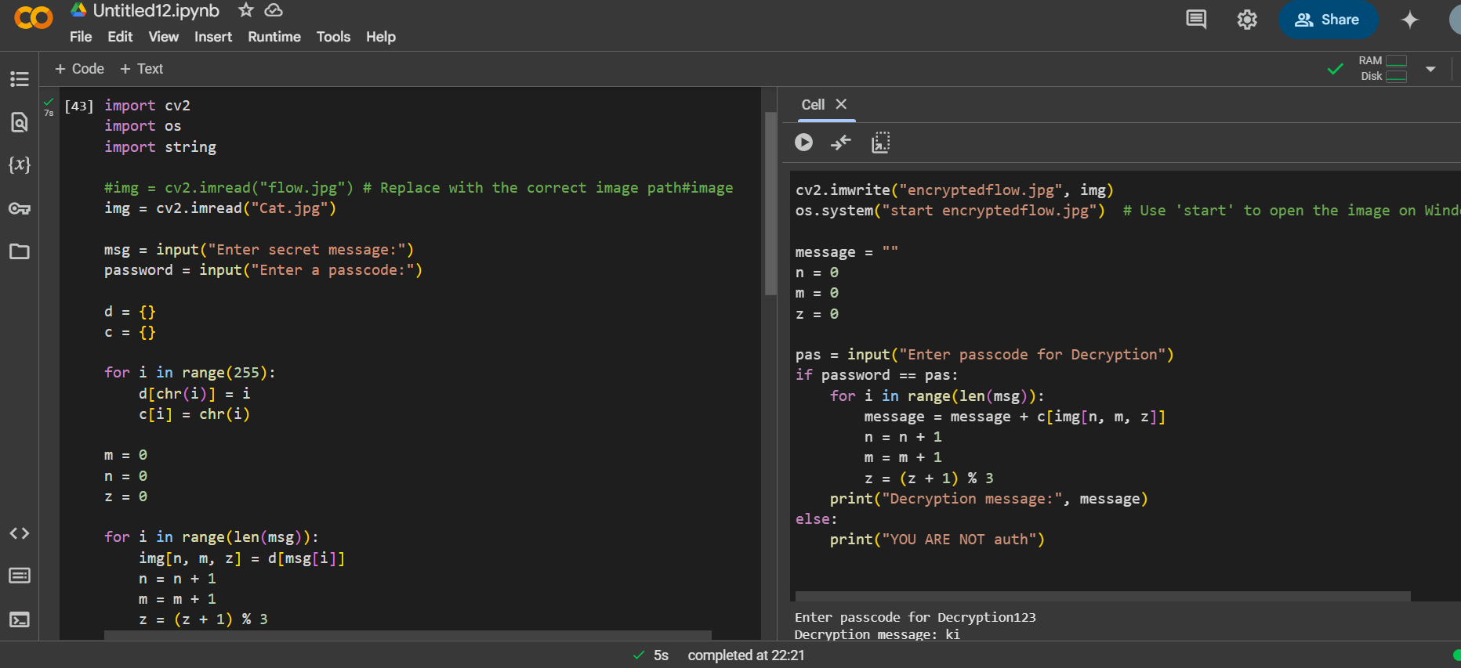
Results
Figure 1: Code

Slide 8
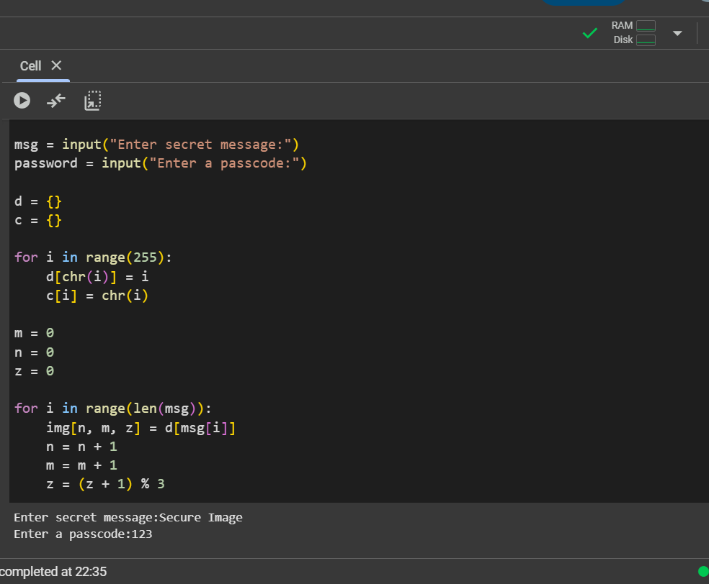
Figure 2: Encryption Output

Slide 9
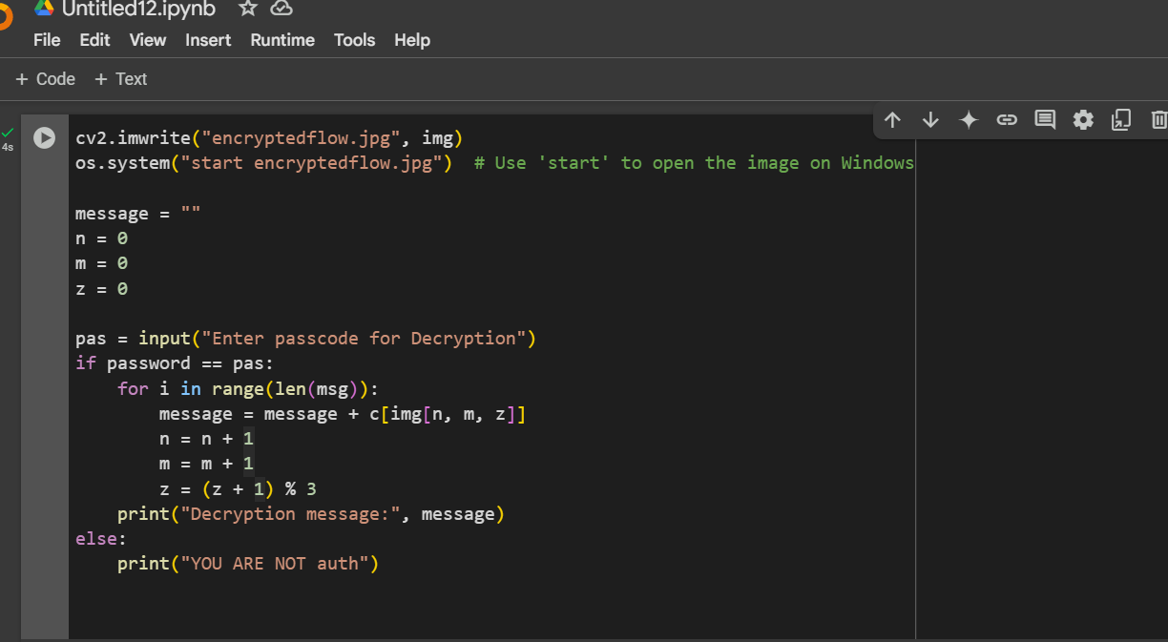
Figure 3: Decryption code

Slide 10
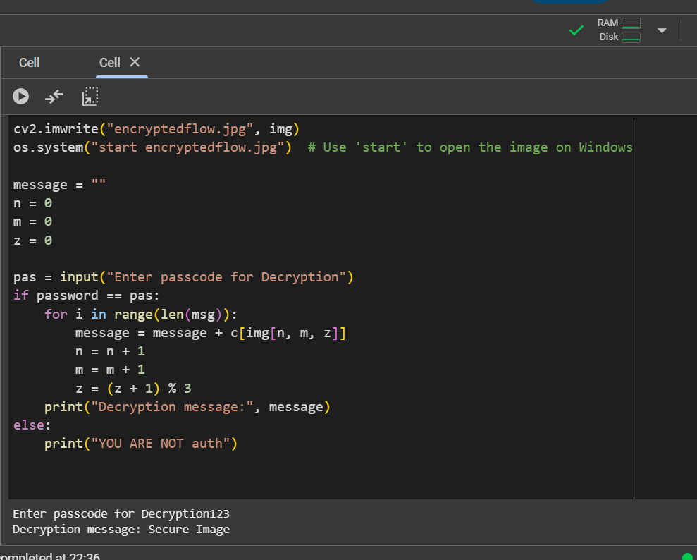
Figure 4: Decryption Output

Slide 11
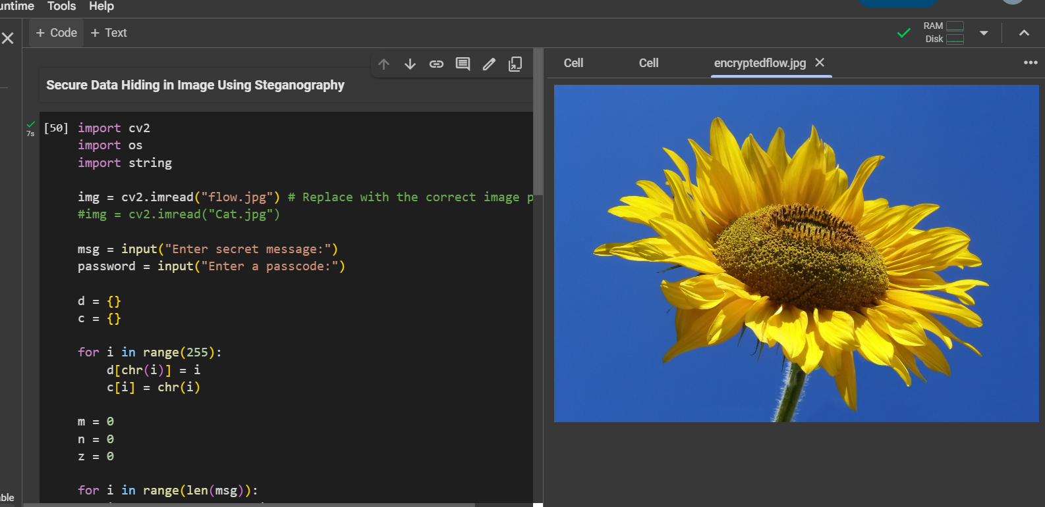
Figure 5 : Encrypted Image

Slide 12
Conclusion
This project provides a simple yet effective way to securely encrypt messages within images using steganography and password protection.
The system is made accessible to both technical and non-technical users.
The use of OpenCV enables fast and efficient message embedding and extraction without significant image distortion.
The project successfully demonstrates a practical application of image-based cryptography for secure communication.

Slide 13
GitHub Link
github.com/Akriti-43/Secure-Data-Hiding-in-Images-using-Steganography

Slide 14
Future scope(optional)
Enhanced Security – Implement AES or RSA encryption alongside steganography for a dual-layer security approach.
Frequency Domain Techniques – Embed data in the frequency domain (e.g., using Discrete Cosine Transform, like in JPEG compression.
Mobile & Web Integration – Develop a Mobile app or Web-based version for wider accessibility.
Cloud Storage – Store Steganography encoded images in the cloud.
Authentication and Integrity Verification: Embed a digital signature or hash to verify image authenticity.

Slide 15
THANK YOU

